Slide 1
Building Data Lake using AWS Glue in Nutshell
Sharad Bagal (Sr. Big Data Cloud Architect)
TOGAF® 9.2
AWS Certified Solution Architect - Professional
AWS Certified Solution Architect - Associates
AWS Certified Security – Specialty

Slide 2
AWS Glue
AWS Glue is one of those AWS services that are relatively new but have enormous potential.
This service could be very useful to all those companies that work with data and do not yet have powerful Big Data infrastructure.
Basically, Glue is a fully AWS-managed pay-as-you-go ETL service without the need for provisioning instances (we can combines the speed and power of Apache Spark with the data organization offered by Hive Metastore.)
Migrating Data from DW systems (on premises Hadoop) to the AWS redshift using AWS Glue for analytics/reporting.
Building Data Lakes on AWS using Glue.
ETL jobs in Glue to bring data from various sources, normalize it , pivot it and make it available to Data Scientist to build their models.
AWS Glue is server less catalog and ETL service, provides data catalog which is central metadata repository which is hive meta store compatible.
The catalog helps automatically discover metadata associated with your data and then add that as table definition to a metadata.
ETL jobs in Glue are jobs runs on a server less spark environment.
Glue helps automatically generates scripts either in Python or Scala, these scripts are customizable (we can bring our own code) and run it.

Slide 3
AWS Glue Features
Discover and search across all your AWS data sets.
It provides the serverless data integration.
Build complex ETL pipelines with simple job scheduling.
Clean and transform streaming data in-flight.
Combine and replicate data across multiple data stores using SQL.
Normalize data without code using a visual interface.
End to End Encryptions.
DynamoDB Connections (use DynamoDB as Source to the Glue ETL)
Metadata access policies.
Glue Integration with Amazon Sage Maker.
Provides visual and code based interfaces to make data integration.
Users can easily find and access data using AWS Glue Data Catalog.
Data Engineers/Developers can visually create, run and monitor ETL workflows with AWS Glue Studio.
Data Scientist/Data analyst can use AWS Glue Databrew to visually enrich, clean and normalize data.

Slide 4
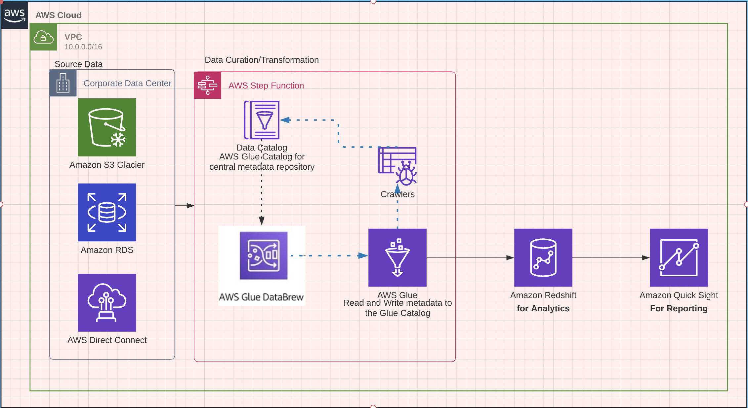
AWS Glue Pipeline

Slide 5
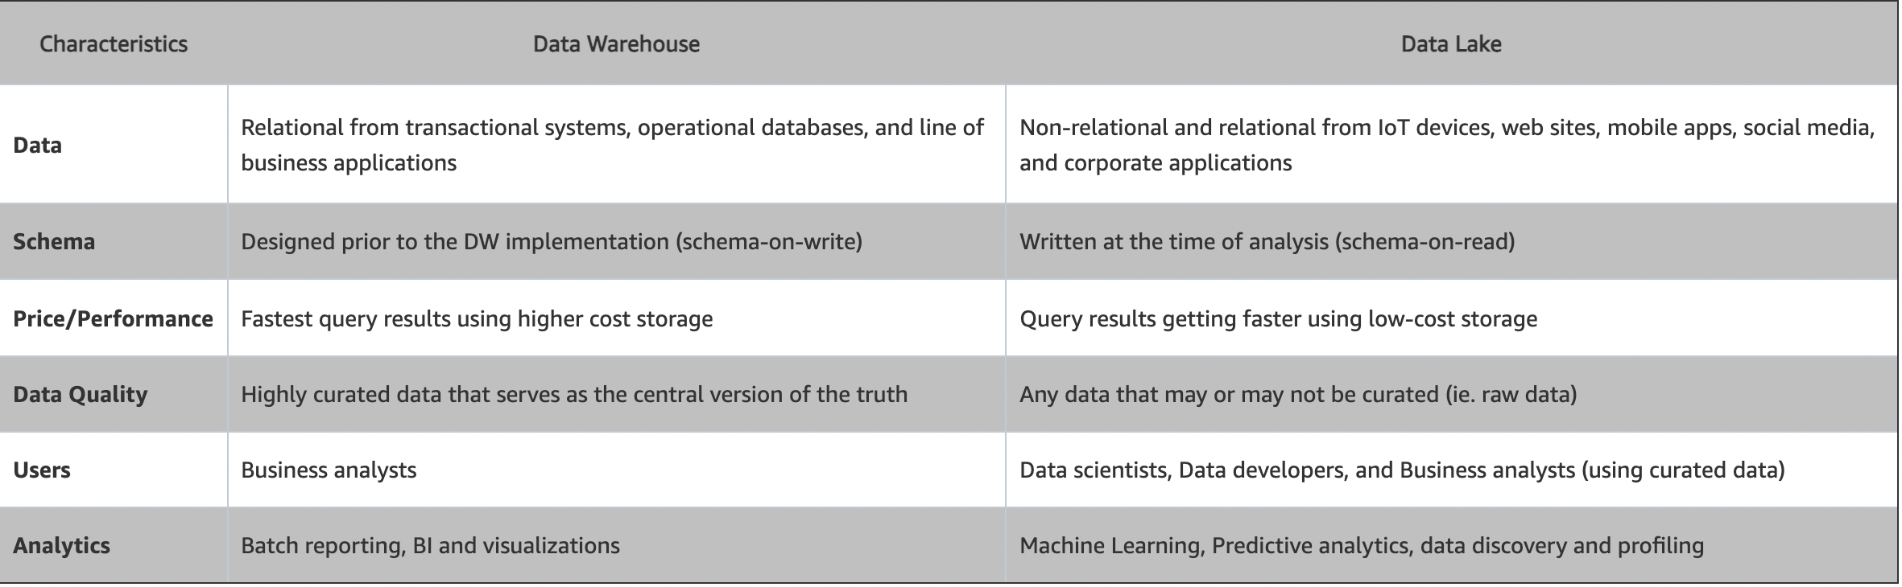
Building Data Lakes on AWS
Why Data Lakes:
Allows you to store centrally Structured, Semi Structure or Un structured data coming from Relational as well as non - relational databases
It stores at massive scale and supports a variety of analytical tools to derive insights from this massive data.
Low in cost.
You can build the business intelligence or Data Warehousing solution

Slide 6
Things to consider while Building Data Lake Cont….
Storage
S3 forms a great storage layer for data lakes
S3 is an object store, build to store and retrieve any amount of data anywhere
Have most comprehensive security and compliance capabilities.
AWS Lake Formation can also be used to store centralized, curated and secure data repositories.
AWS S3 Glacier can be used for low cost achieve storage in the cloud
Move
Use AWS Direct Connect, AWS Snowball, AWS Migration Service and AWS Storage Gateways to bring on premises data into AWS S3
Ingest and load stream data using AWS Kinesis, Kinesis data streams and Kinesis video streams:
Amazon Kinesis Data Firehose
Amazon Kinesis Data Streams
Load IoT data using AWS IoT Core.
Amazon managed services for Apache Kafka (MSK) can be used to move real time steams. This is fully managed and highly available secure kafka service.

Slide 7
Things to consider while Building Data Lake Cont….
Data Lake (Process Data using Glue and make it available for analytics and Catalog) :
AWS Glue makes your data more discoverable
Glue transforms, curate and partition data
AWS Glue automatically discovers and profiles your data via the Glue Data Catalog, recommends and generates ETL code to transform your source data into target schemas, and runs the ETL jobs on a fully managed, scale-out Apache Spark environment to load your data into its destination.
AWS DataBrew Glue- Data Transformation
Handling/Imputing missing values
Combining DataSets
Union a a transformation
Joining datasets
Creating Columns
Creating column using functions
Creating a Flag column
Filtering Data
Aggregating Data
Handling Categorial Values
Handling Numerical Values

Slide 8
Things to consider while Building Data Lake Cont….
AWS Glue Crawler
Crawler automatically build your data catalog and keep it in sync with source and target
It does automatically discovers new data, extracts schema definitions
Detects Schema changes and version tables
Detects Hive style partitions on Amazon S3
Crawlers can be run on schedule to keep track any schema changes or partition changes as they arrive
Crawler runs on server less environment that glue provides
Need to pay only when Crawler runs
Crawlers comes with built in set of classifiers that help them identify wide variety of data format (we can write our own using grok expressions)
We can write our own scripts for data transformations using Library provided in Glue ETL Library

Slide 9
Things to consider while Building Data Lake Cont….
Glue Job Bookmark
Glue ETL keeps track of incremental job runs using job bookmarks and identifies the data which has already processed
Based on the job bookmarks Glue ETL process the deltas and avoid refreshing/processing full data
We can reuse Glue ETL jobs by parameterizing the code that is part of ETL job, code is stored at S3 bucket and same script can be used across multiple AWS Glue jobs
Triggers in Glue
It helps to form a workflow of jobs and stitch jobs together
Jobs to the work and triggers helps stitch different jobs together to build complex workflows
3 types of triggers we have in Glue
Schedule based trigger
Event based
On demand - Use AWS Lambda to start the jobs on events such as Amazon S3 put notifications
Helps mix and match conditions using the controls we have in glue
We can trigger based on all the conditions are met.
Job Monitoring
Job metrics and sparked metrics are pushed to AWS Cloudwatch
Also available thru the AWS Glue console and useful when
Debug any Exceptions (OOM)
Data skews
Plan DPU capacity

Slide 10
Securing Data Lake
By Default S3 buckets are private
Use resource based policies and IAM policies or IAM user policies
Use AWS KMS to enable client and server side encryption for your data
Along with securing data, we need to secure metadata of this data
Use IAM based user policies
Resource based policies
One policies per catalog
Below are the resources on which we can define permissions
Catalog
Database
Connection
Table
Function

Slide 11
Sharing the Data for Analytics
Make available data to all the users and applications available in organization
Measure, understand, optimize audiences
Easily integrate AI into media content workflows
Increase content discovery, accessibility, and personalization
Glue catalog can share data to below:
AWS Athena
AWS Redshift Spectrum (Serverless) – fast, simple cost-effective data warehousing
AWS Elastic Map Reduce for hosted Hadoop framework data processing
AWS QuickSight for fast business analytics
AWS Kinesis for analyzing real time data streams

Slide 12
AWS Glue Use Cases
Create a unified catalog to find data across multiple data stores:
You can use the AWS Glue Data Catalog to quickly discover and search across multiple AWS data sets without moving the data. Once the data is cataloged, it is immediately available for search and query using Amazon Athena, Amazon EMR, and Amazon Redshift Spectrum.
Create, run, and monitor ETL jobs without coding:
AWS Glue Studio makes it easy to visually create, run, and monitor AWS Glue ETL jobs. You can compose ETL jobs that move and transform data using a drag-and-drop editor, and AWS Glue automatically generates the code. You can then use the AWS Glue Studio job run dashboard to monitor ETL execution and ensure that your jobs are operating as intended.
Explore data with self-service visual data preparation:
AWS Glue DataBrew enables you to explore and experiment with data directly from your data lake, data warehouses, and databases, including Amazon S3, Amazon Redshift, AWS Lake Formation, Amazon Aurora, and Amazon RDS. You can choose from over 250 prebuilt transformations in AWS Glue DataBrew to automate data preparation tasks, such as filtering anomalies, standardizing formats, and correcting invalid values. After the data is prepared, you can immediately use it for analytics and machine learning.
Build materialized views to combine and replicate data:
AWS Glue Elastic Views enables you to use familiar SQL to create materialized views. Use these views to access and combine data from multiple source data stores, and keep that combined data up-to-date and accessible from a target data store. The AWS Glue Elastic Views preview currently supports Amazon DynamoDB as a source, with support for Amazon Aurora and Amazon RDS to follow. Currently supported targets are Amazon Redshift, Amazon S3, and Amazon OpenSearch Service (successor to Amazon Elasticsearch Service), with support for Amazon Aurora, Amazon RDS, and Amazon DynamoDB to follow.
Build event-driven ETL (extract, transform, and load) pipelines:
AWS Glue can run your ETL jobs as new data arrives. For example, you can use an AWS Lambda function to trigger your ETL jobs to run as soon as new data becomes available in Amazon S3. You can also register this new dataset in the AWS Glue Data Catalog as part of your ETL jobs

